Slide 1
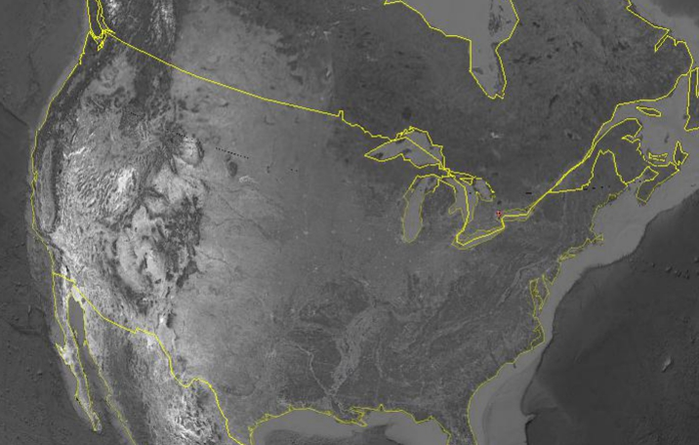
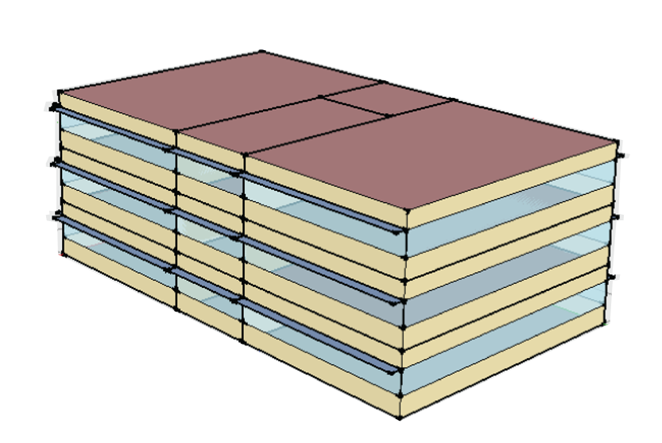
OPEN STUDIO Building Simulation
TECHNICAL ENVIRONMENTAL SYSTEMS
W18 ANDREA FOPPIANI
MELISSA MARTINOLI
DAVIDE MONTANARI
LISANA SHIDQINA

Slide 2
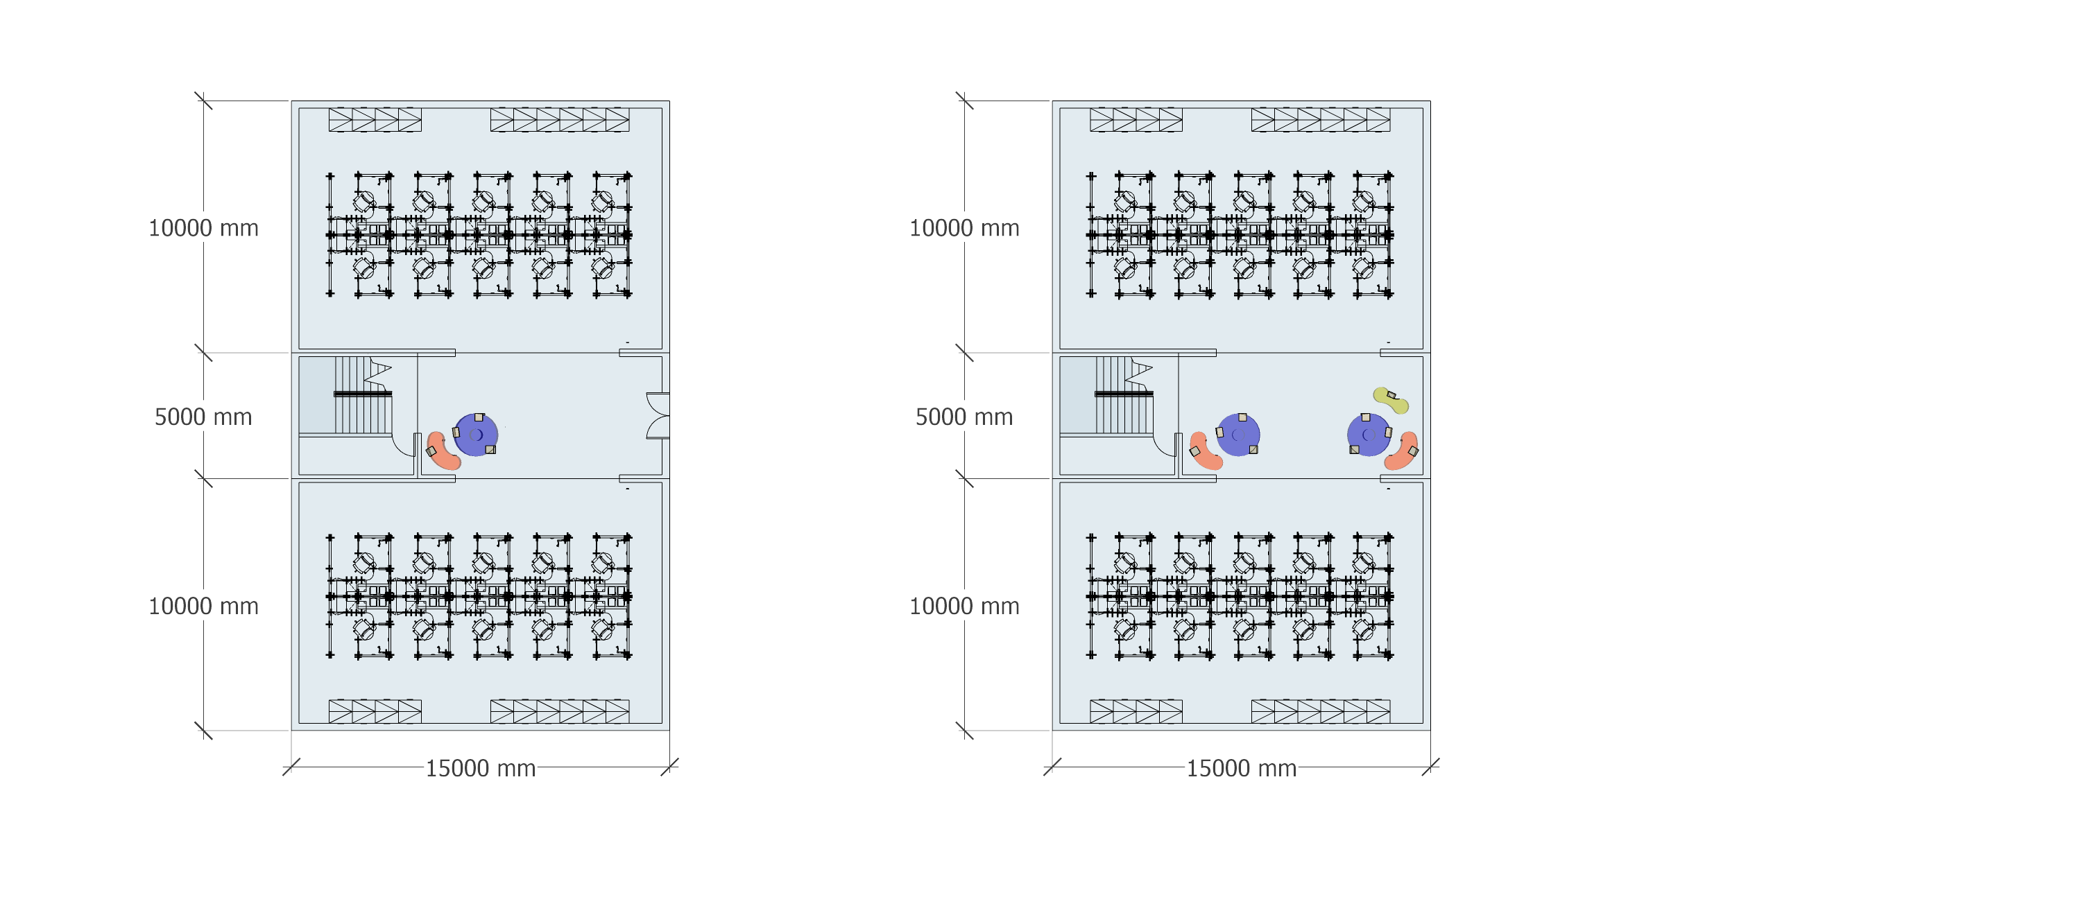
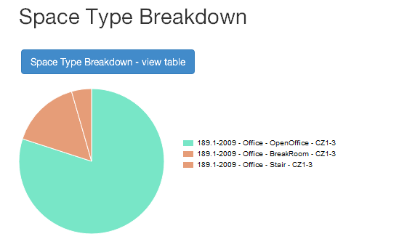
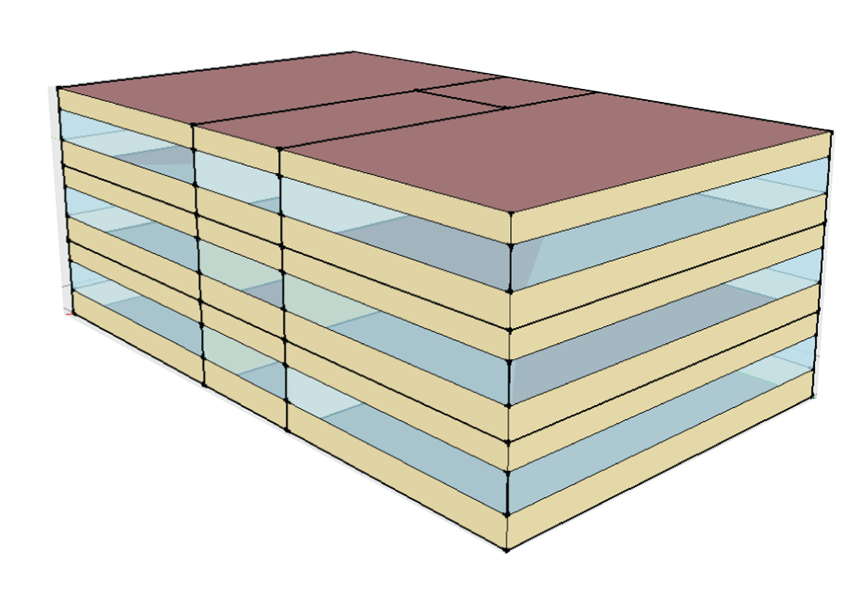
FLOOR PLAN & BUILDING DETAILS
OPEN OFFICE
OPEN OFFICE
SPACE TYPE BREAKDOWN
STAIRS
BREAK ROOM
STAIRS
BREAK ROOM
BUILDING
WITH 40% WINDOW/WALL RATIO
OPEN OFFICE
OPEN OFFICE
TOTAL BUILDING AREA: 1125 M²
BUILDING WITH OVERHANGS (EXCLUDING NORTH SIDE)
GROUND FLOOR PLAN
TYPICAL 1ST & 2ND FLOOR PLAN

Slide 3



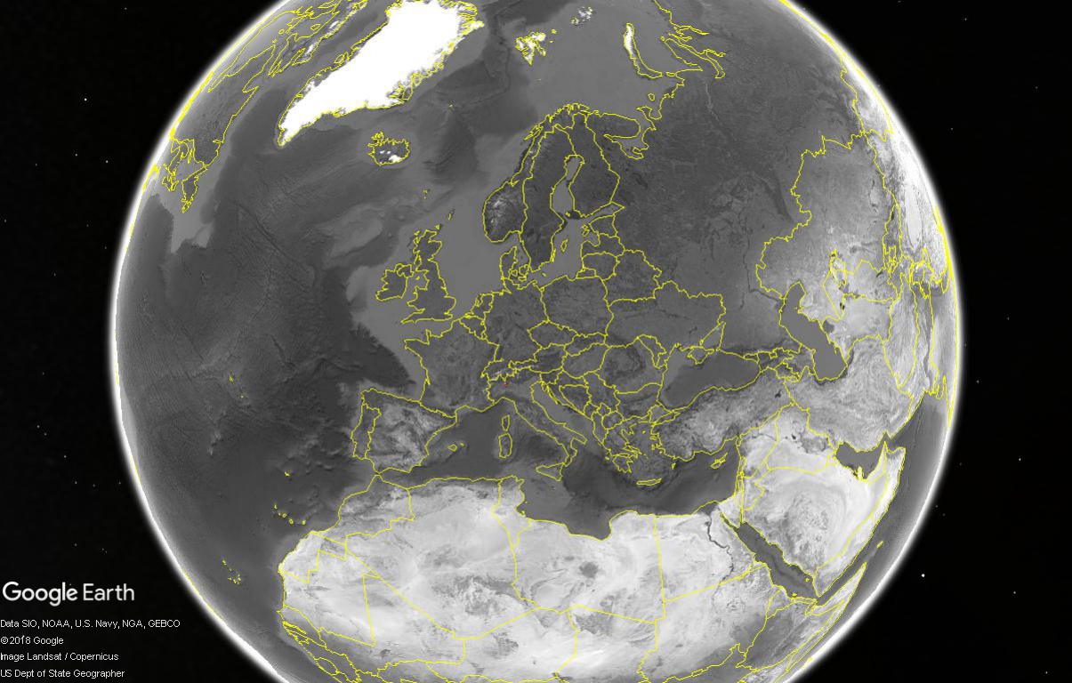
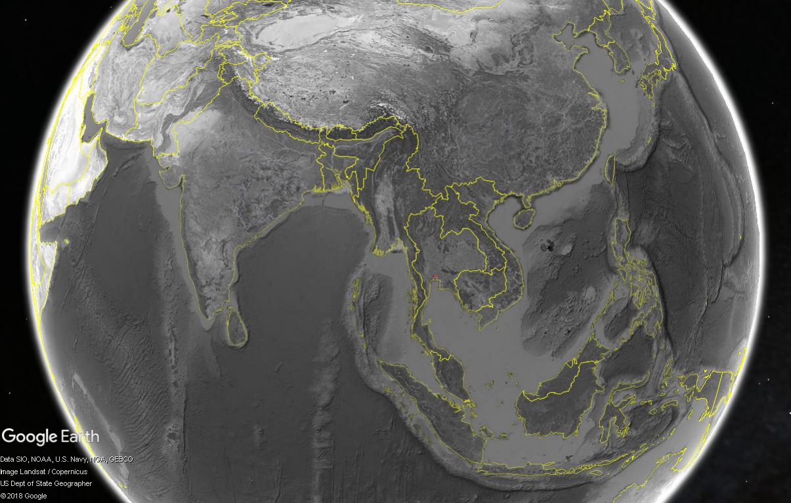
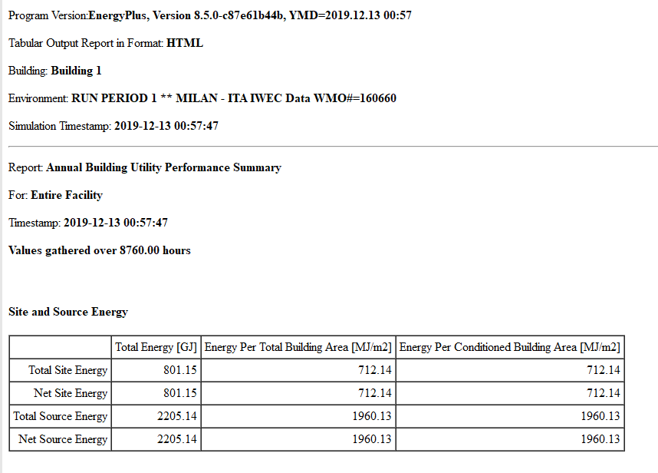
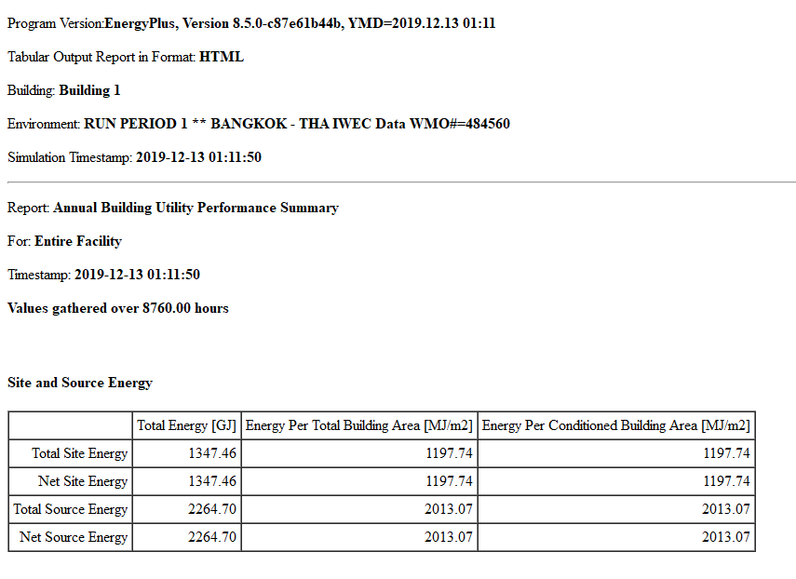
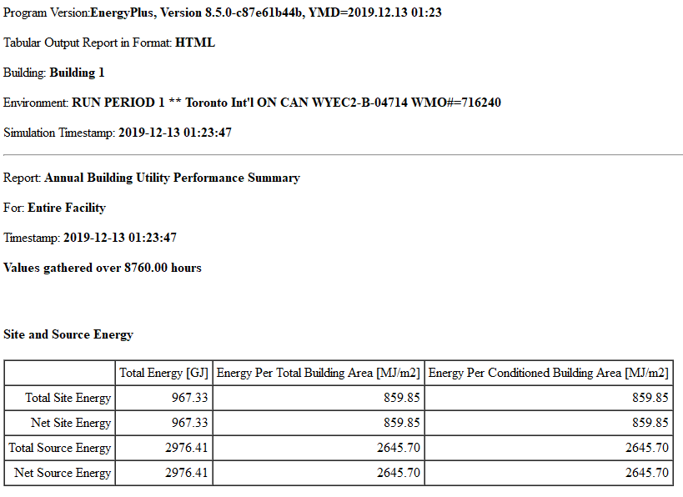
OVERVIEW
Location, climate conditions, and energy consumption per location
MILAN
BANGKOK
TORONTO
Max. temp: 33ºC
Min. temp: -5.1ºC
Max. temp: 37.2ºC
Min. temp: 19ºC
Max. temp: 31.2ºC
Min. temp: -18.8ºC
45.4642° N, 9.1900° E
13.7563° N, 100.5018° E
43.6532° N, 79.3832° W
HIGHEST ENERGY CONSUMED

Slide 4
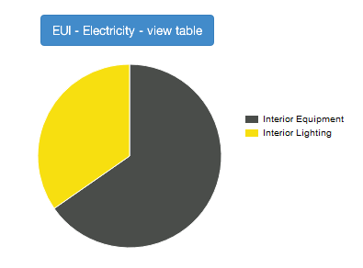
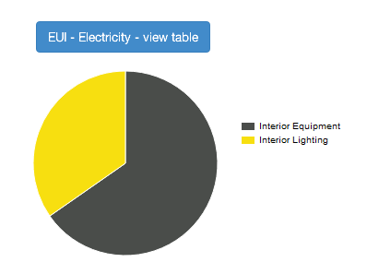
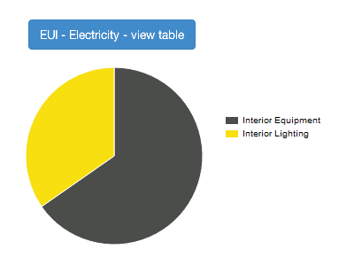
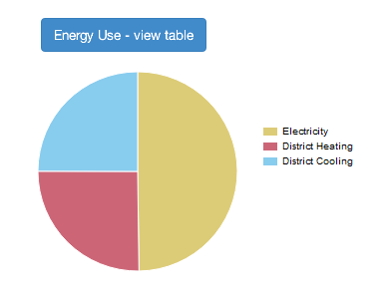
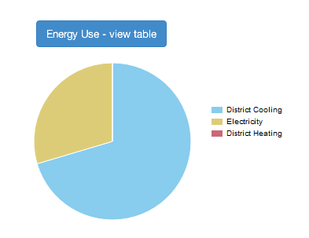
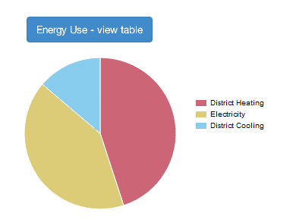
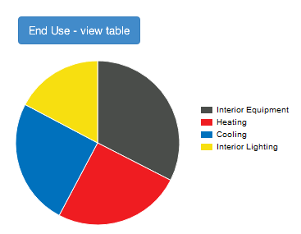
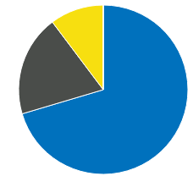
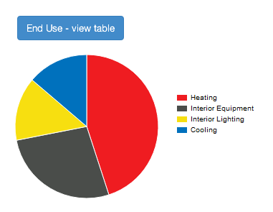
OPEN STUDIO RESULTS
Different climates influence different aspects of the end use
MILAN
BANGKOK
TORONTO
ELECTRICITY
ENERGY USE
END USE
MORE INTERIOR EQUIPMENT NEEDED
NO HEATING,
BUT SIGNIFICANT COOLING NEEDED
HIGHEST HEATING NEEDED

Slide 5
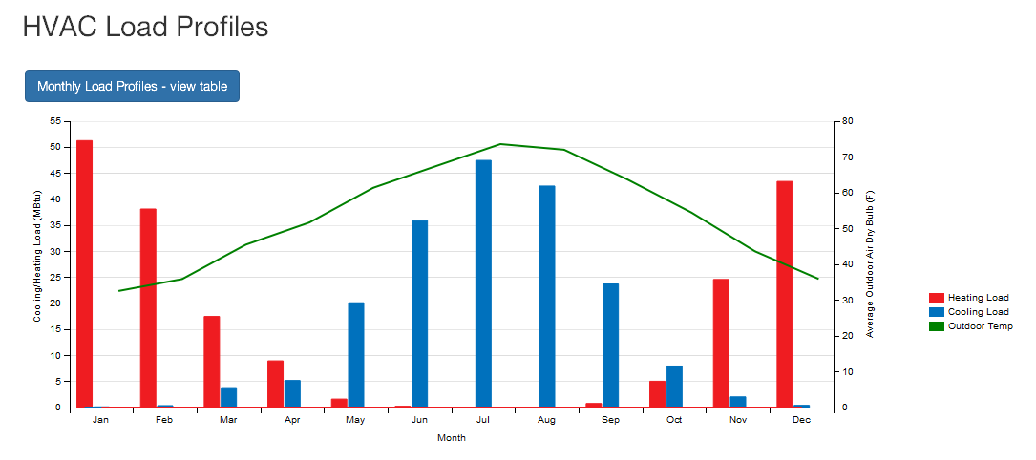
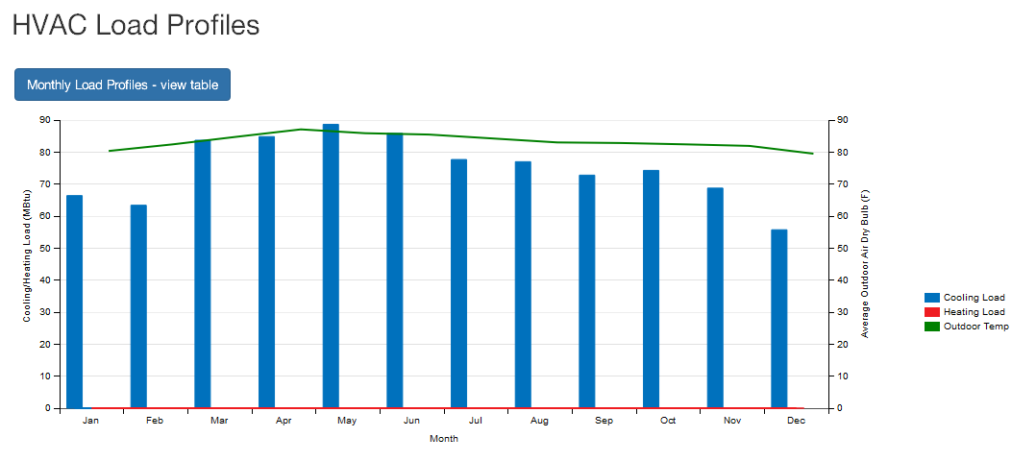
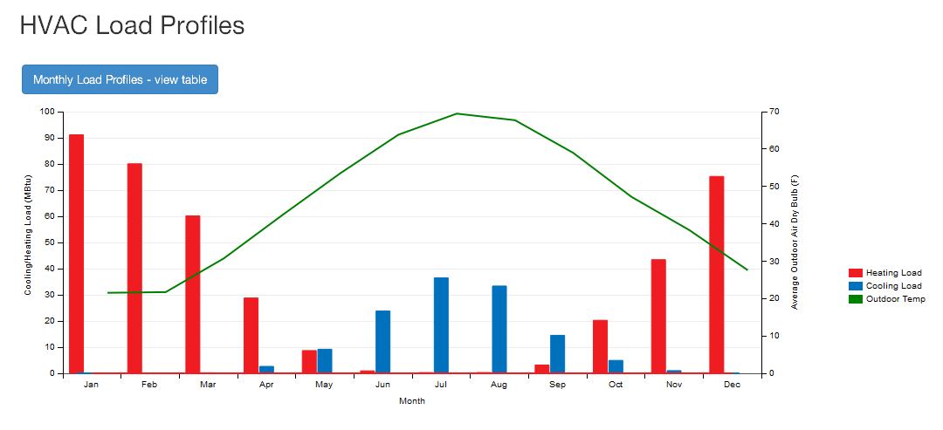
OPEN STUDIO RESULTS
Overall heating & cooling loads relating to the outdoor temperature in each location
MILAN – HVAC LOAD PROFILES
ALTERNATING TEMPERATURE, ALTERNATING ENERGY NEEDS
BANGKOK – HVAC LOAD PROFILES
CONSTANT HIGH TEMPERATURE & COOLING NEED
TORONTO – HVAC LOAD PROFILES
HIGHER TEMPERATURE DIFFERENCES, MOST HEATING NEEDED

Slide 6
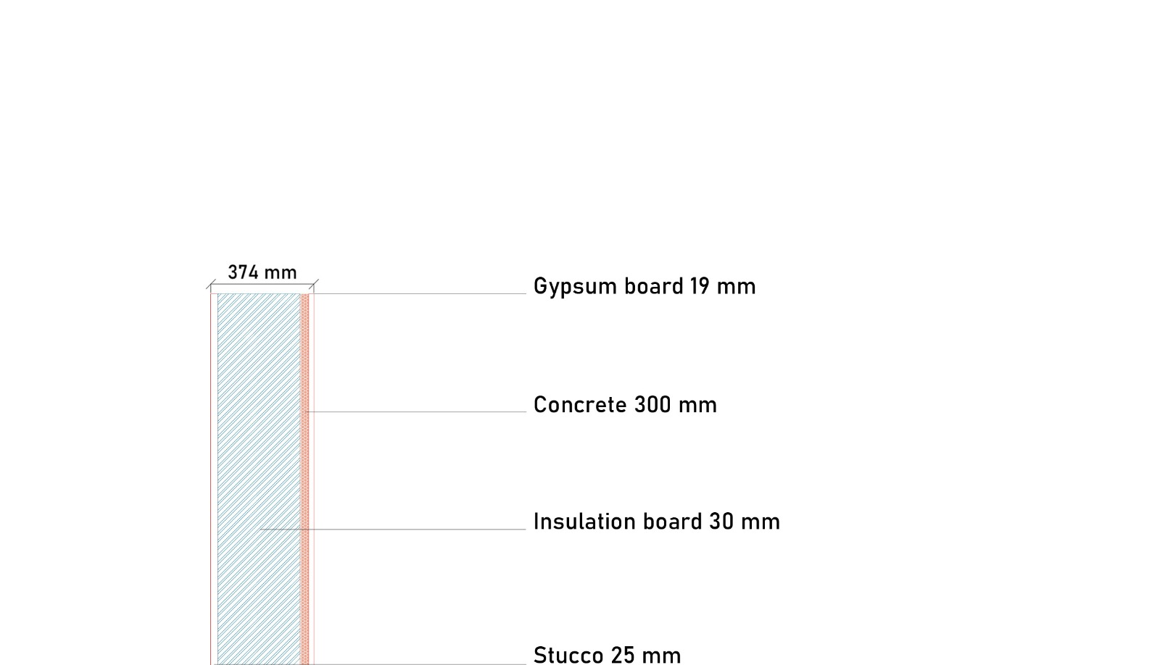
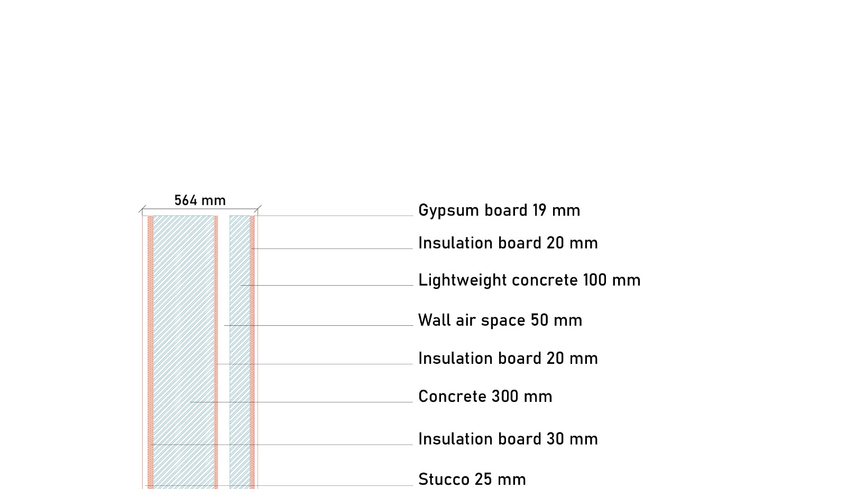
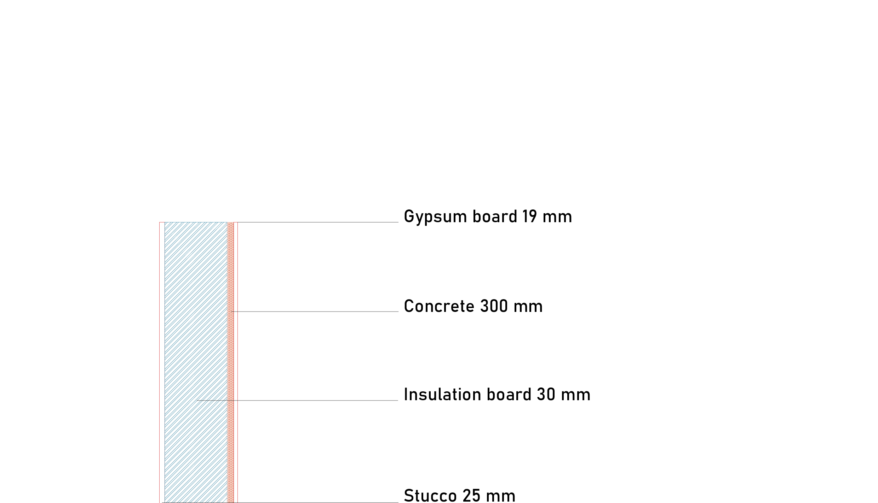
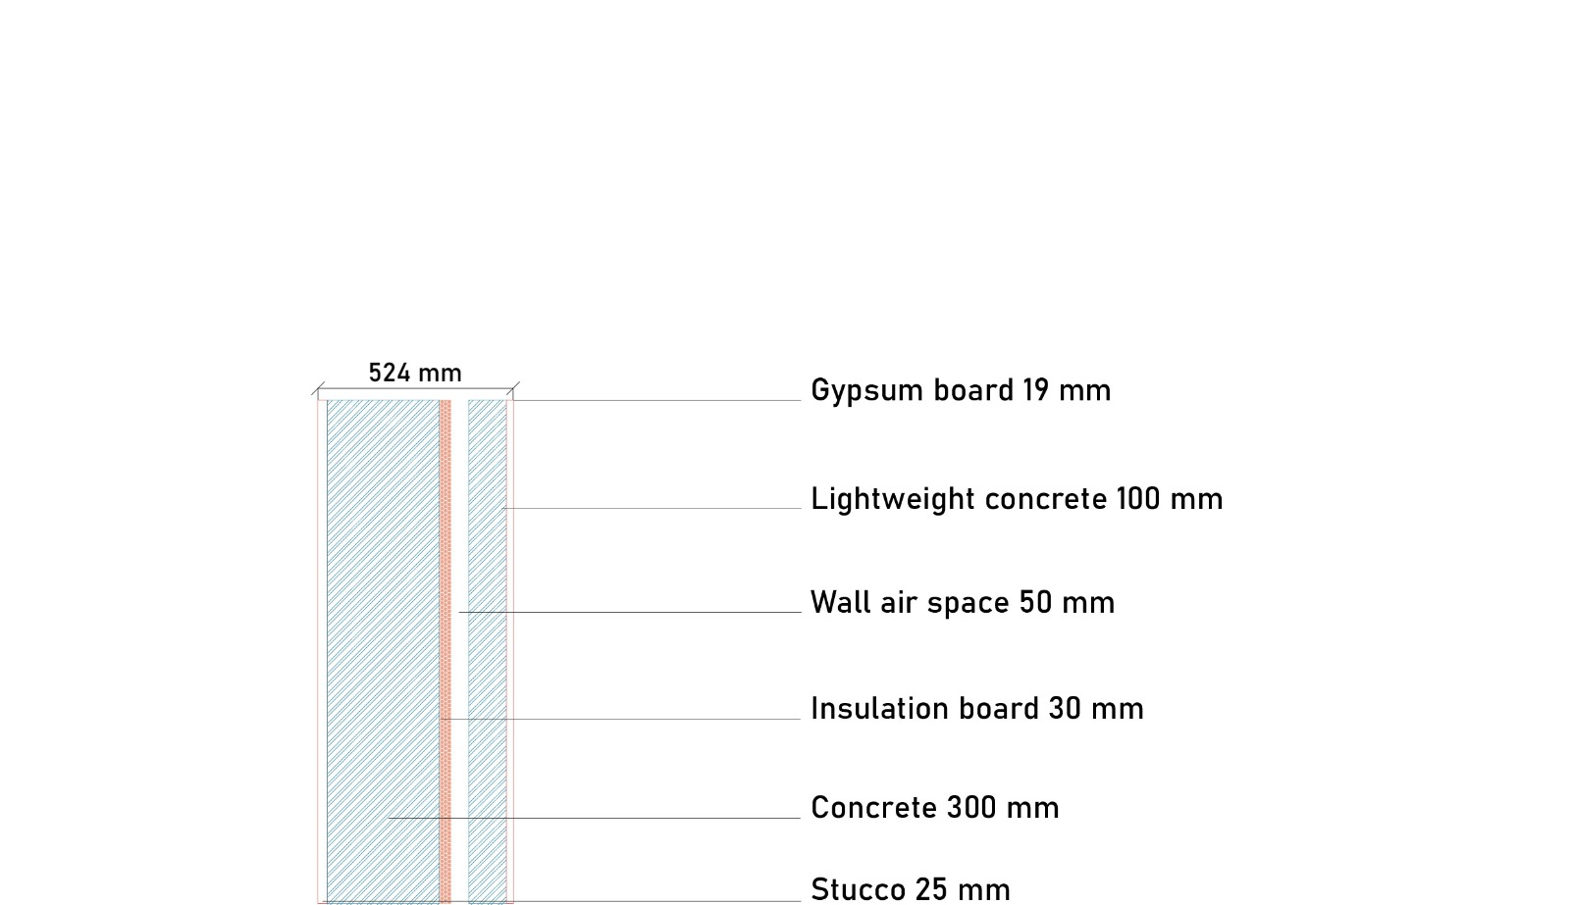
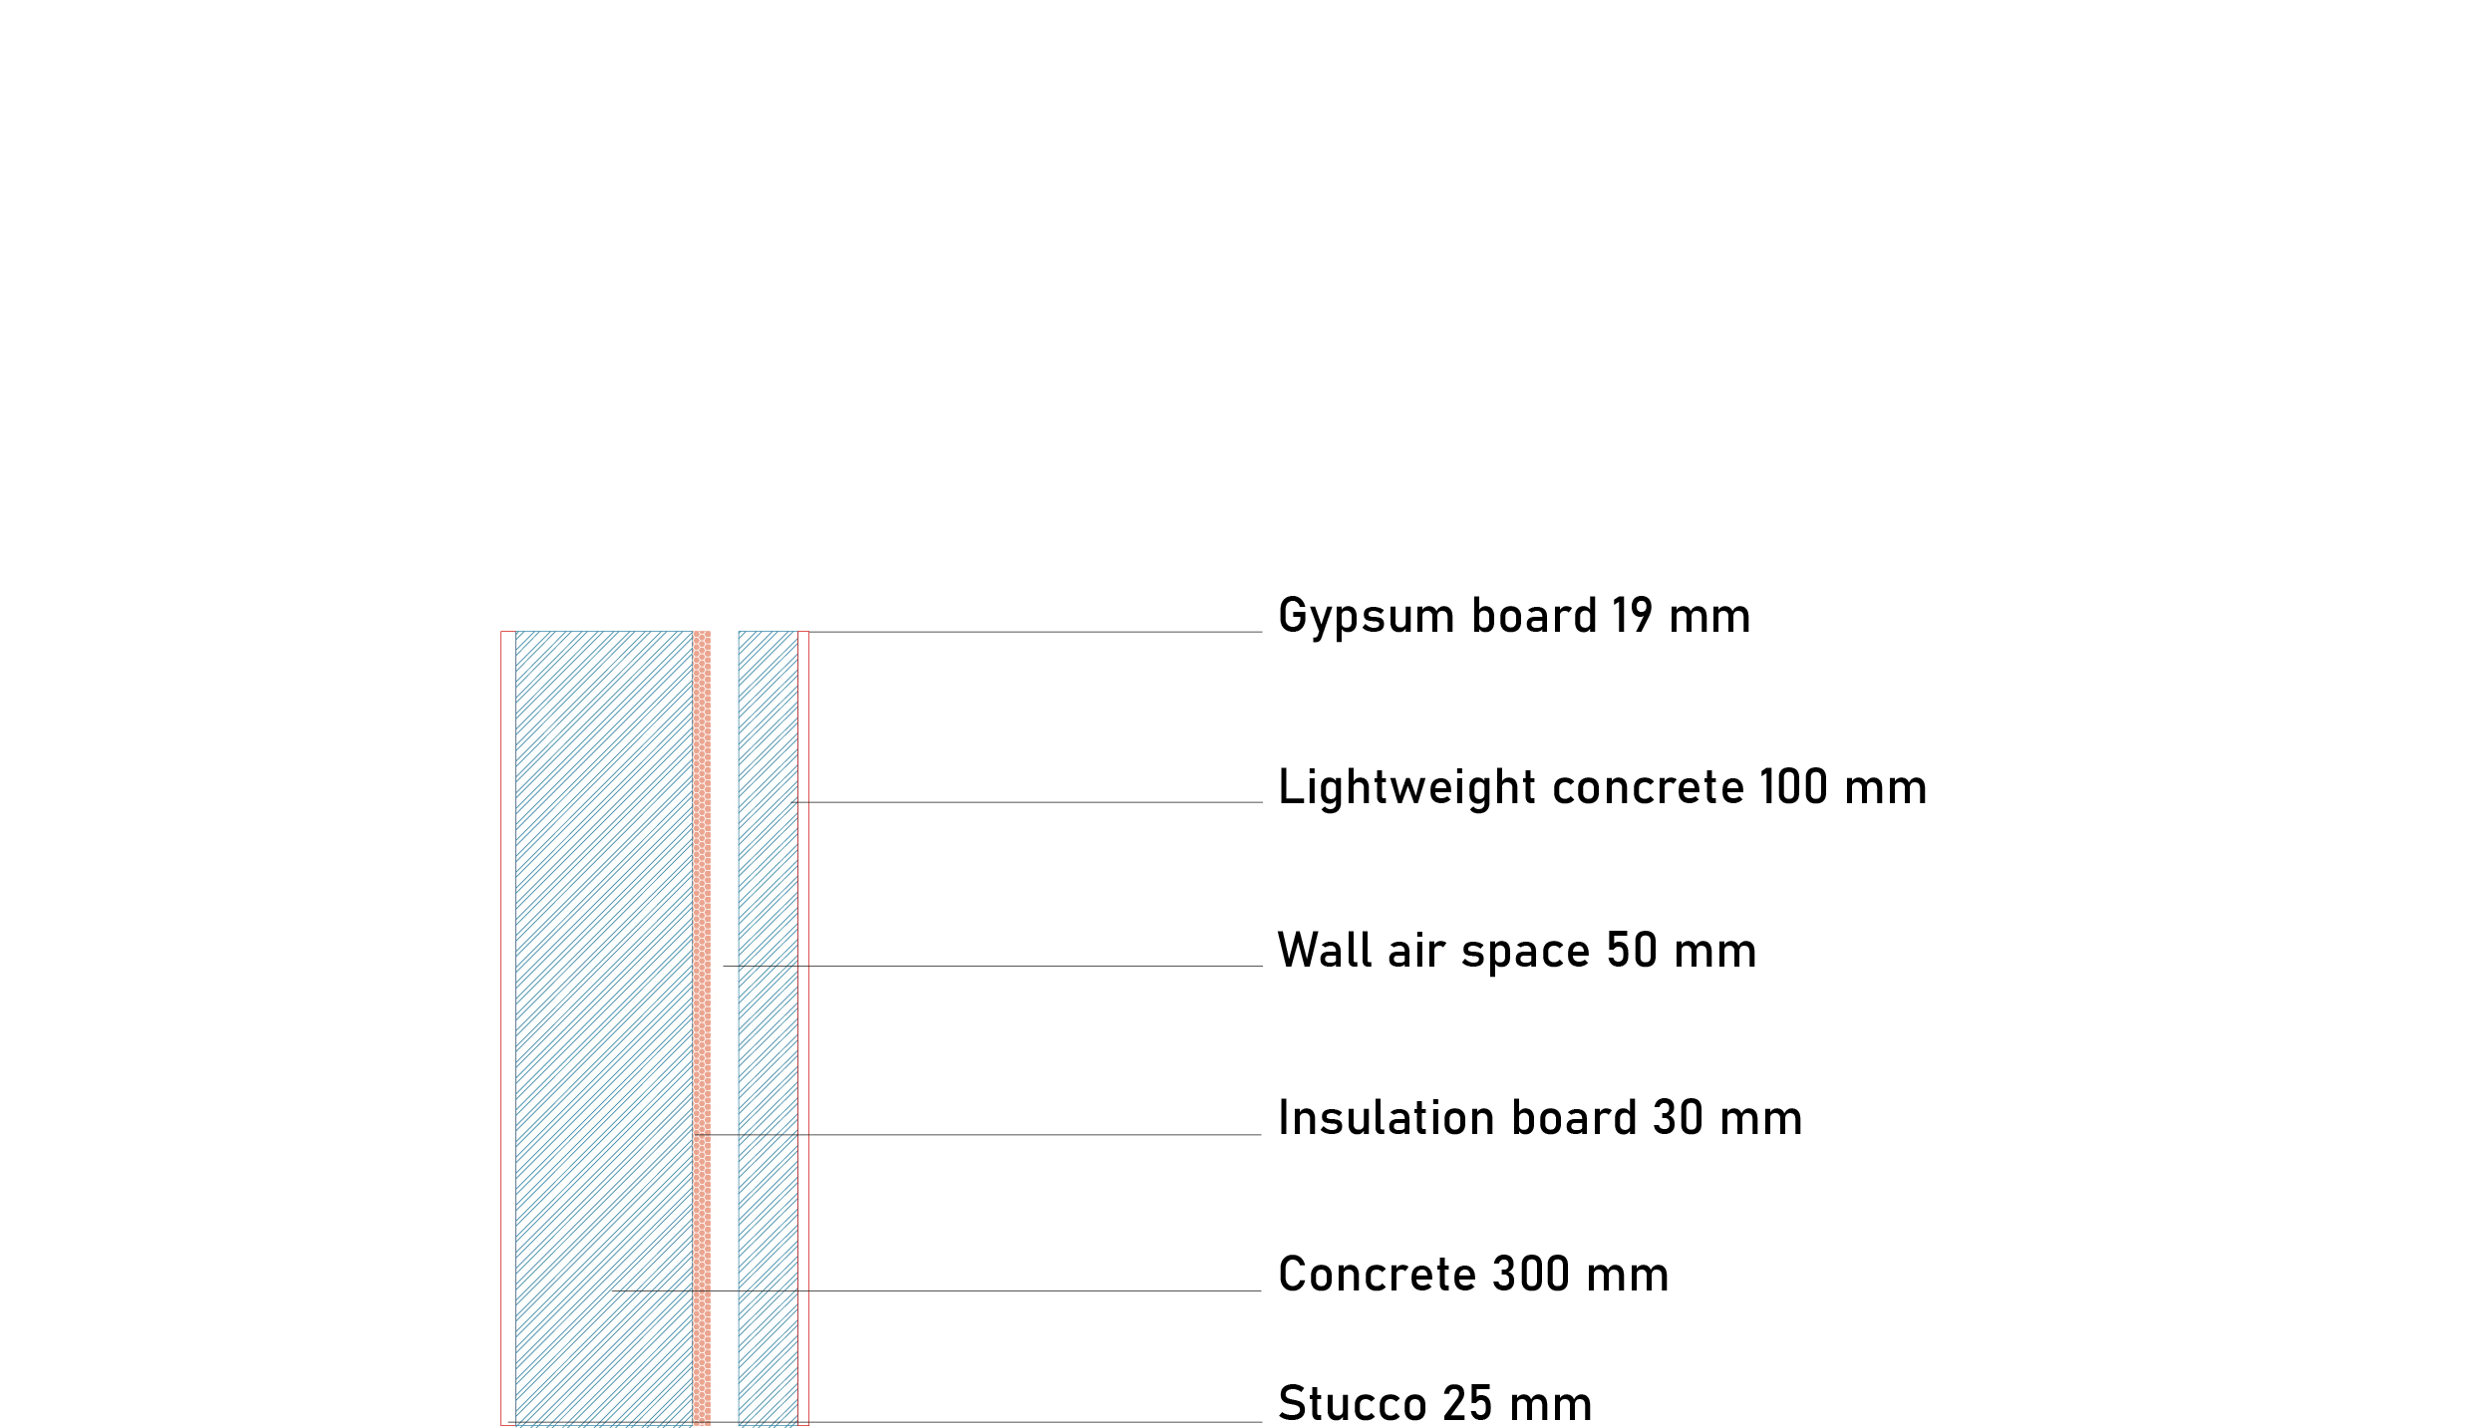
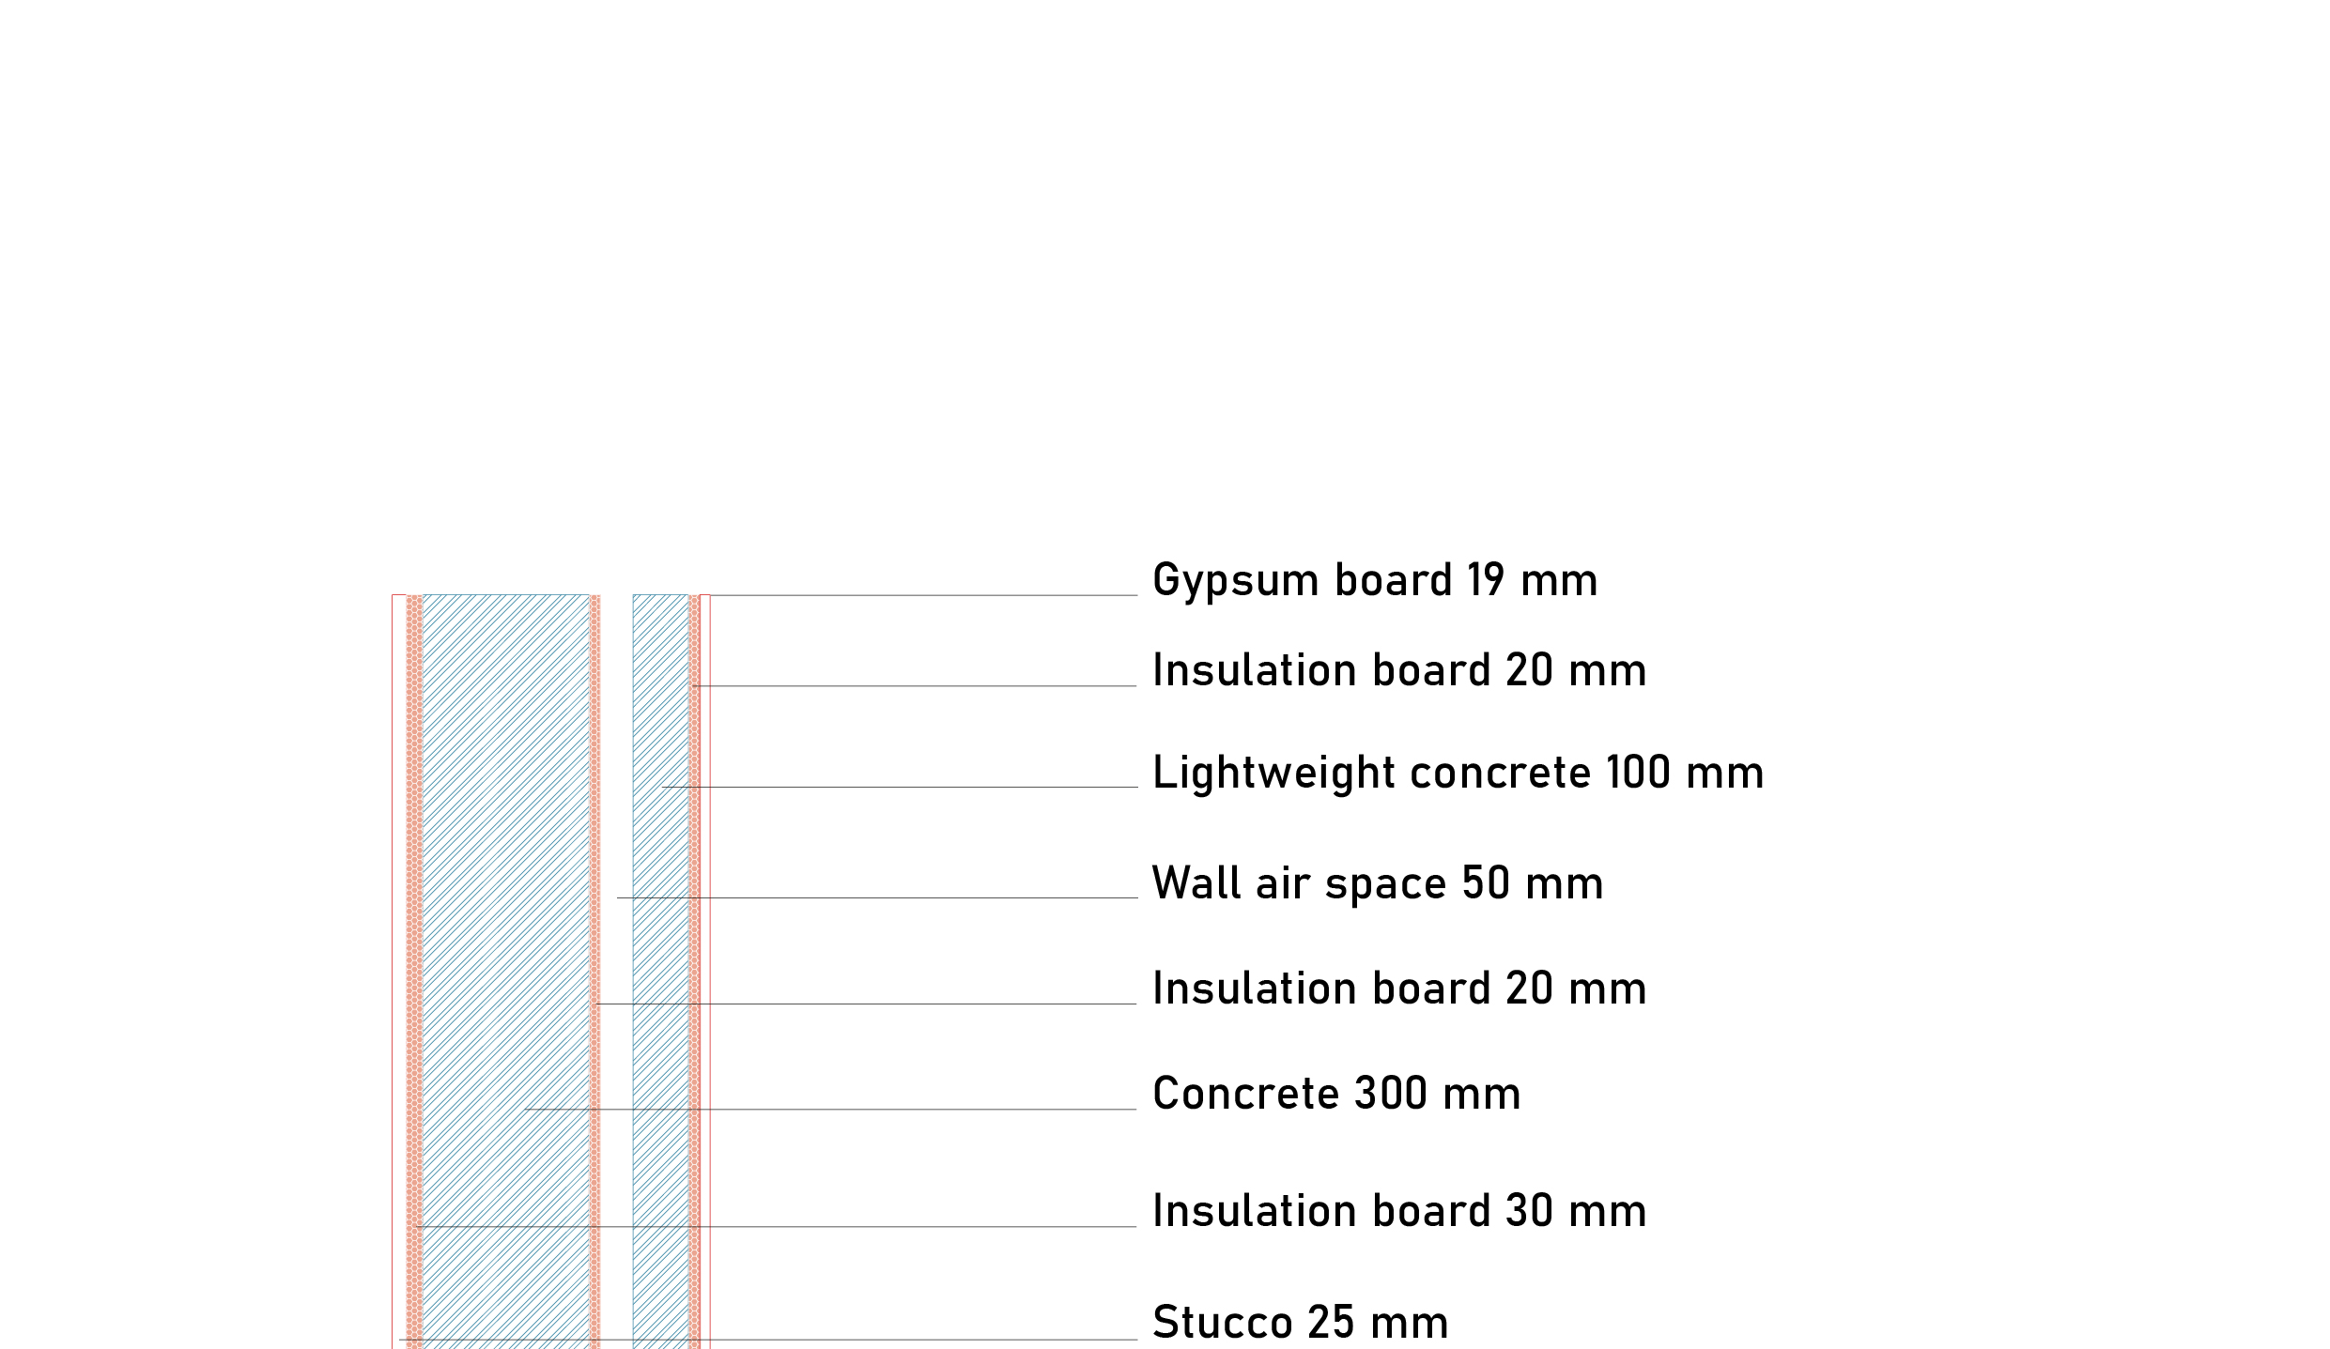
WALL SIMULATION PROFILES
TORONTO
Simulation on different wall types to overcome climatic problems.
Max. temp: 31.2ºC
Min. temp: -18.8ºC
43.6532° N, 79.3832° W
WALL 1 : BASE CASE
WALL 2 : Base case + air layer and light concrete
WALL 3 : Base case + air layer and light concrete + second and third insulation layer
TOTAL SITE ENERGY: 953.90 GJ
R-VALUE: 7.55 FT² * h * R / Btu
U-VALUE: 0.749 W / m² * K
WINDOW U-FACTOR: 1.13 Btu / FT² * h * R
TOTAL SITE ENERGY: 938.61 GJ
R-VALUE: 10.05 FT² * h * R / Btu
U-VALUE: 0.562 W / m² * K
WINDOW U-FACTOR: 1.13 Btu / FT² * h * R
TOTAL SITE ENERGY: 923.05 GJ
R-VALUE: 17.62 FT² * h * R / Btu
U-VALUE: 0.317 W / m² * K
WINDOW U-FACTOR: 1.13 Btu / FT² * h * R
TOTAL SITE ENERGY: 953.90 GJ
R-VALUE: 7.55 FT² * h * R / Btu
U-VALUE: 0.132 Btu / FT² * h * R
WINDOW U-FACTOR: 1.13 Btu / FT² * h * R
TOTAL SITE ENERGY: 938.61 GJ
R-VALUE: 10.05 FT² * h * R / Btu
U-VALUE: 0.099 Btu / FT² * h * R
WINDOW U-FACTOR: 1.13 Btu / FT² * h * R
TOTAL SITE ENERGY: 923.05 GJ
R-VALUE: 17.62 FT² * h * R / Btu
U-VALUE: 0.056 Btu / FT² * h * R
WINDOW U-FACTOR: 1.13 Btu / FT² * h * R

Slide 7
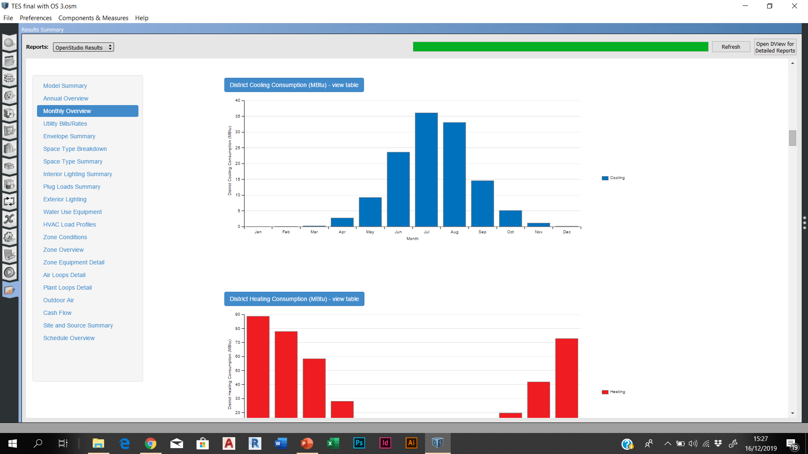
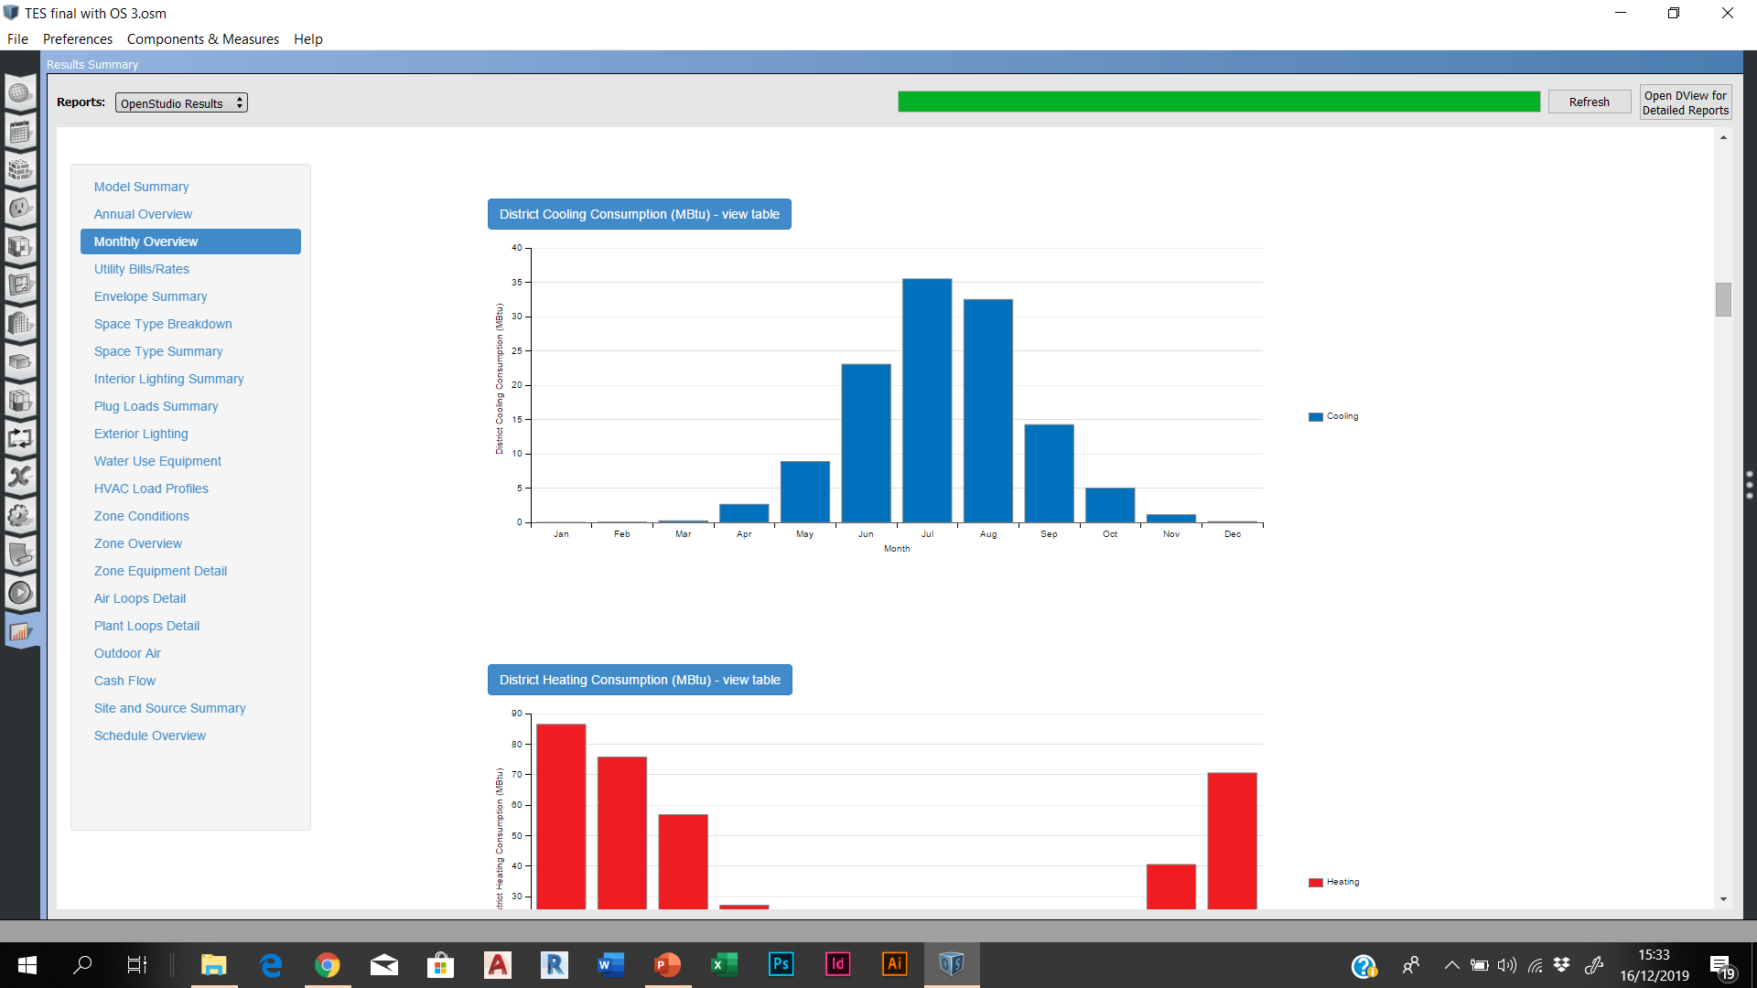
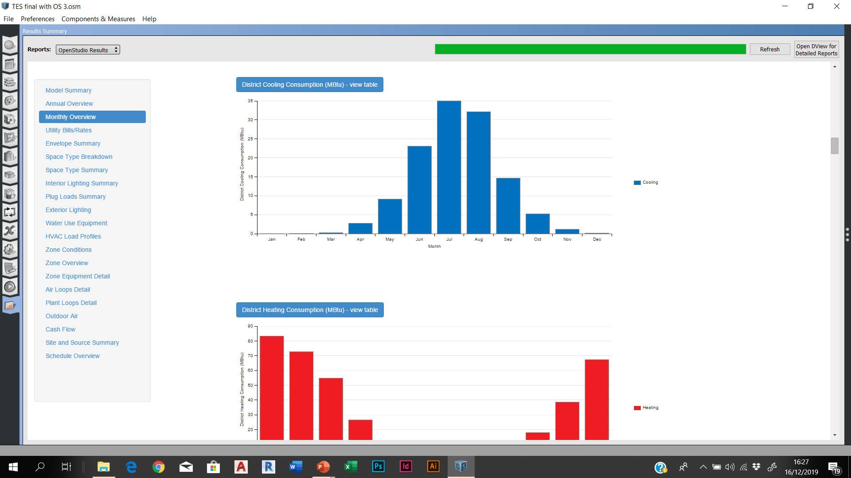
WALL SIMULATION RESULTS - COOLING
WALL 1
36.5
COOLING CONSUMPTION DECREASES SLIGHTLY BETWEEN THE THREE WALLS.
WALL 2
WALL 3
35
36

Slide 8
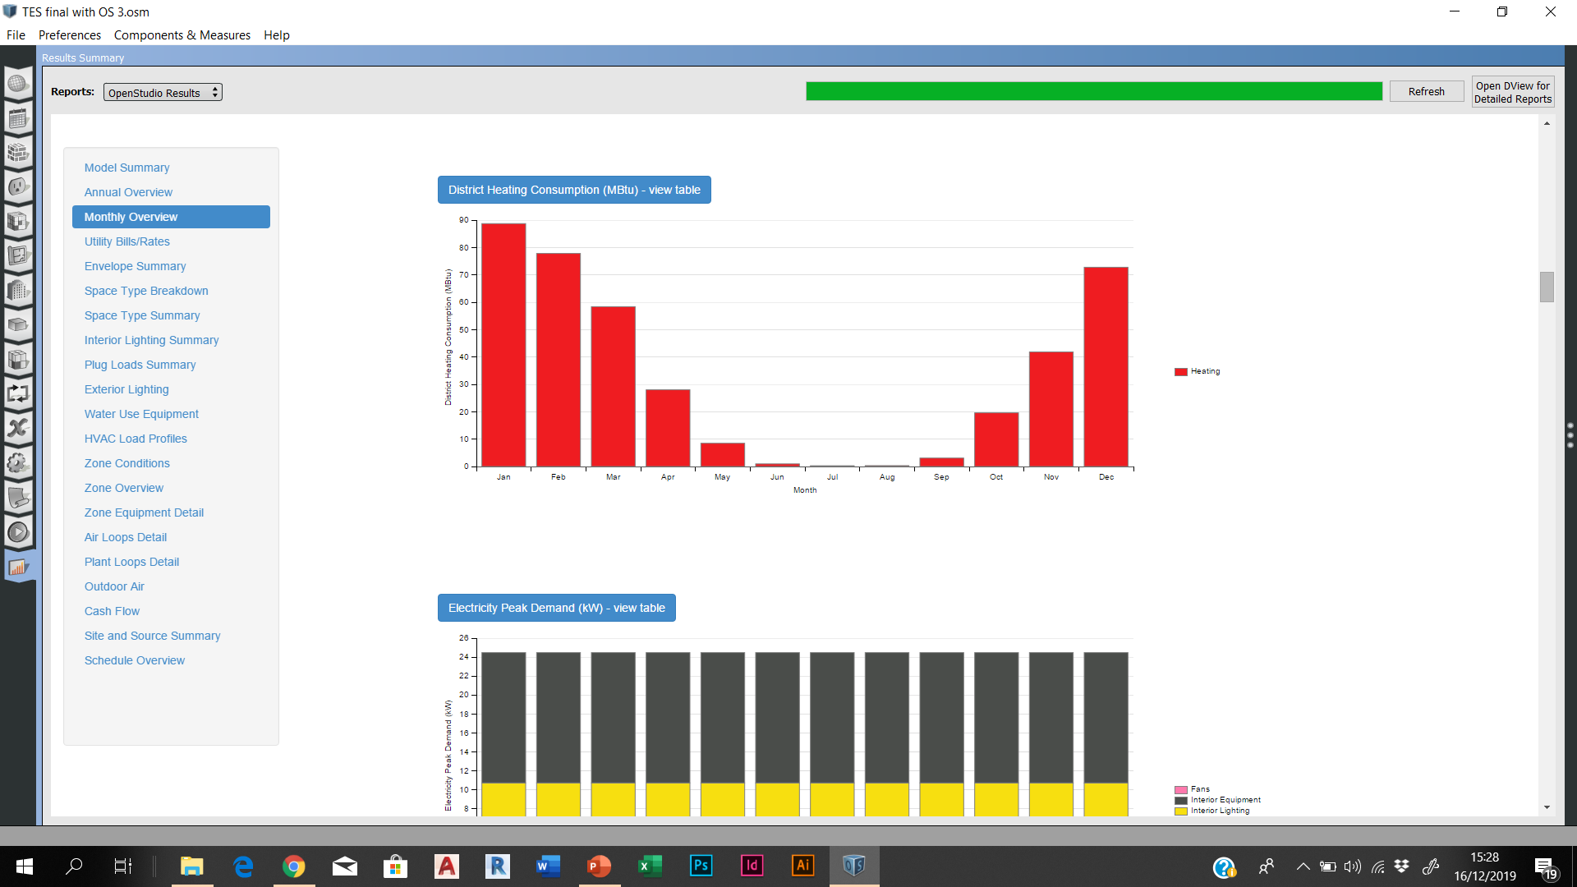
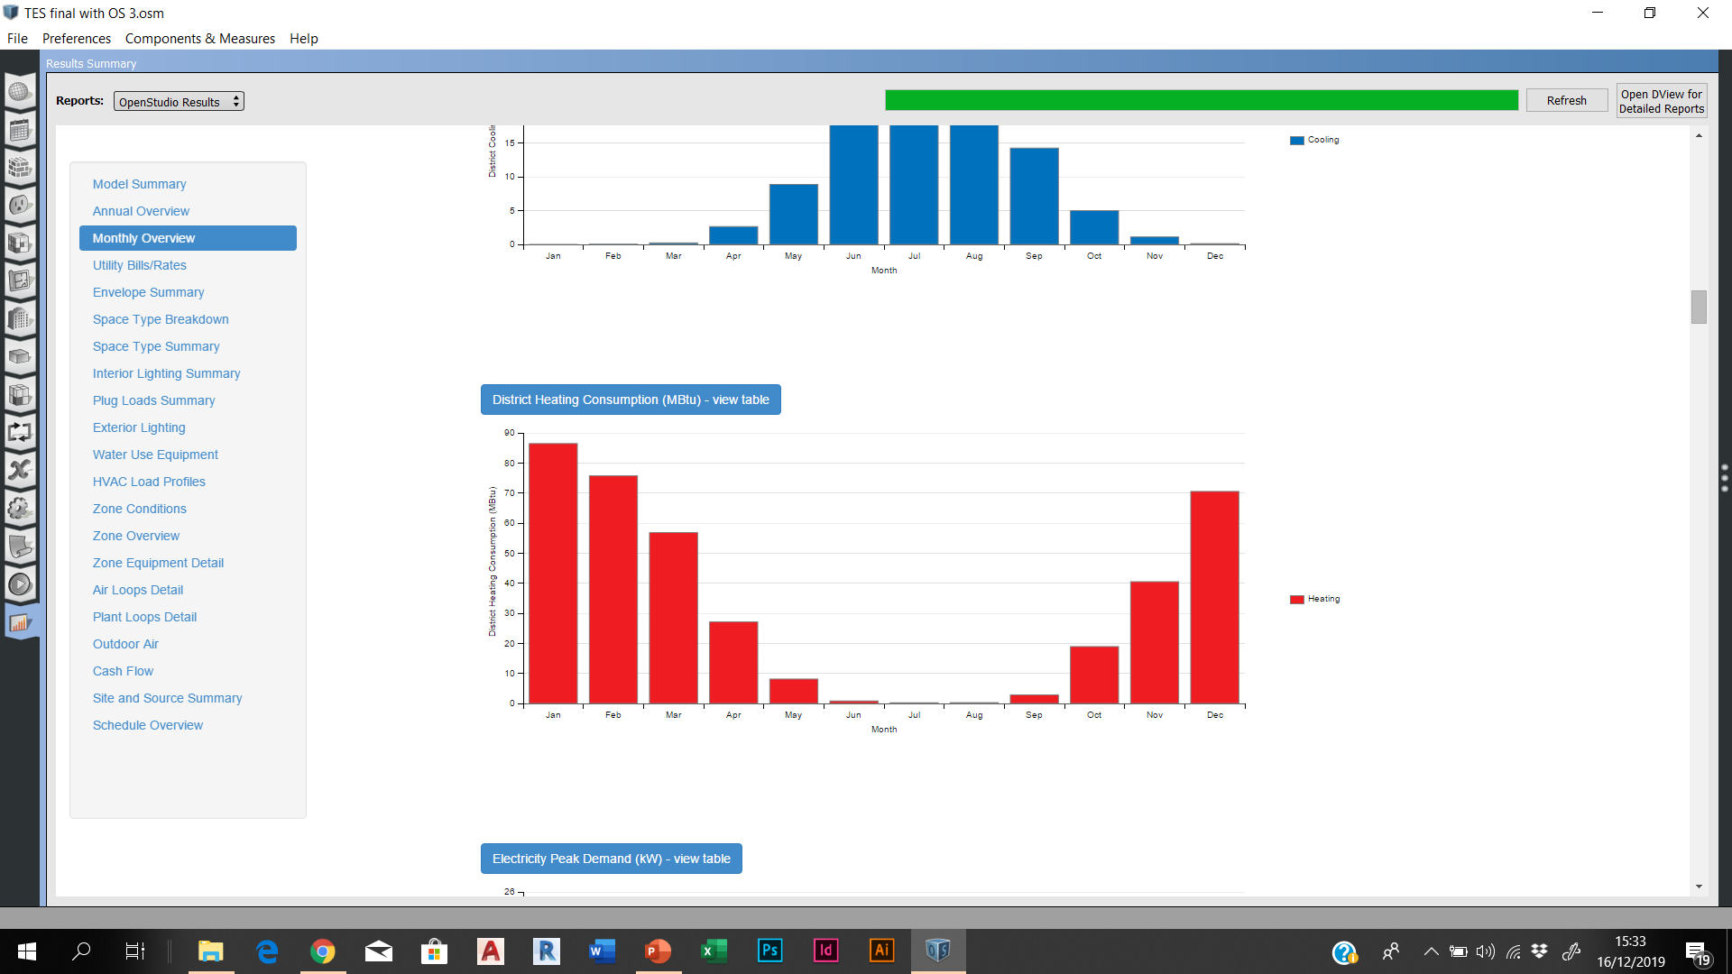
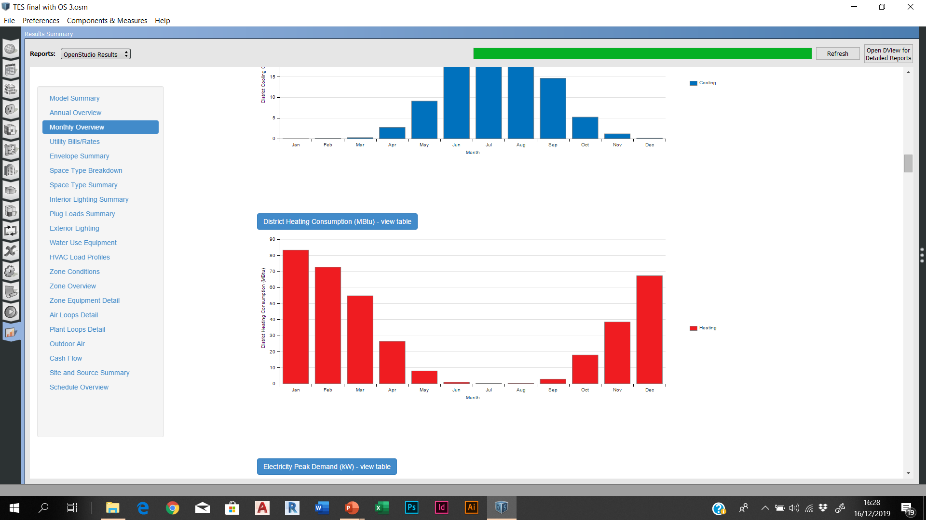
WALL SIMULATION RESULTS - HEATING
WALL 1
88
HEATING CONSUMPTION DECREASES NOTICEABLY BETWEEN THE THREE WALLS.
WALL 2
WALL 3
86
83

Slide 9
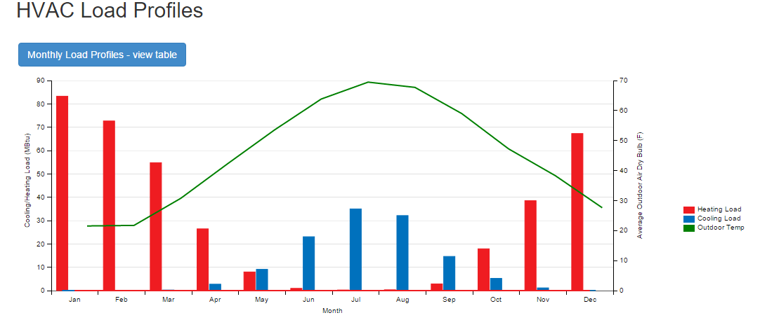
CONCLUSION
Wall 1
WALL 3 : Base case + air layer and light concrete + second and third insulation layer
Wall 2
Wall 1
Wall 2
Adding air gap and extra insulation contributes to the resistance of the wall. The wall is able to retain more energy, and therefore lessen energy loss.
WALL 3 is an ideal solution for the specific location, however,
WALL 2 may be a good economical compromise between the three types of walls.
TOTAL SITE ENERGY: 923.05 GJ
R-VALUE: 17.62 FT² * h * R / Btu
U-VALUE: 0.317 W / m² * K

